Slide 1

CS1020 Data Structures and Algorithms I Lecture Note #6
Vector and ArrayList

Slide 2
Objectives
Using the Vector and ArrayList classes

Slide 3
References
CS1020 website → Resources → Lectures
http://www.comp.nus.edu.sg/ ~cs1020/2_resources/lectures.html
[CS1020 Lecture 6: Vector and ArrayList]

Slide 4
Outline
Vector
1.1 Motivation
1.2 API Documentation
1.3 Example
ArrayList
2.1 Introduction
2.2 API Documentation
2.3 Example
[CS1020 Lecture 6: Vector and ArrayList]

Slide 5
Drawback of Arrays
Array, as discussed in week 2, has a major drawback:
Once initialized, the array size is fixed
Reconstruction is required if the array size changes
To overcome such limitation, we can use some classes related to array
Java has an Array class
Check API documentation and explore it yourself
However, we will not be using this Array class much; we will be using other classes such as Vector and ArrayList
[CS1020 Lecture 6: Vector and ArrayList]

Slide 6
Vector and ArrayList
Both provide re-sizable array, i.e. array that is growable
Both are implementations of the List interface
We will cover interface later, under Abstract Data Types (ADTs)
Differences between Vector and ArrayList are in slide 15
[CS1020 Lecture 6: Vector and ArrayList]

Slide 7
1 Vector class
Class for dynamic-size arrays

Slide 8
Motivation
1. Vector
Java offers a Vector class to provide:
Dynamic size
expands or shrinks automatically
Generic
allows any reference data types
Useful predefined methods
Use array if the size is fixed; use Vector if the size may change.
[CS1020 Lecture 6: Vector and ArrayList]

Slide 9
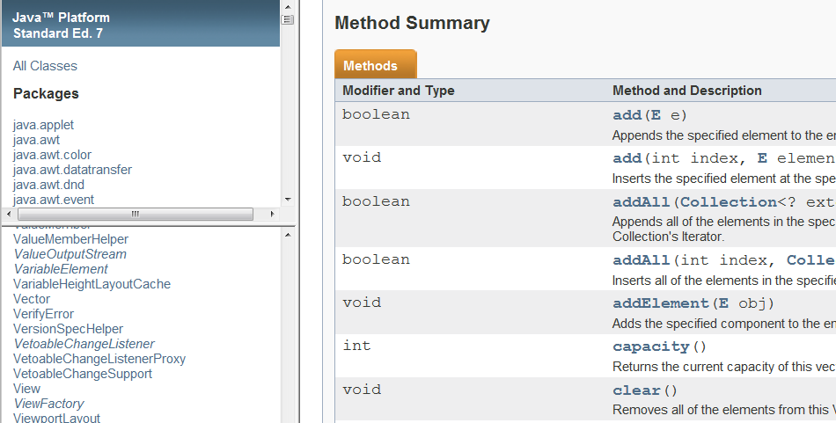
API documentation (1/3)
1. Vector
[CS1020 Lecture 6: Vector and ArrayList]

Slide 10
API documentation (2/3)
1. Vector
PACKAGE
import java.util.Vector;
SYNTAX
//Declaration of a Vector reference
Vector<E> myVector;
//Initialize a empty Vector object
myVector = new Vector<E>();
Commonly Used Method Summary
boolean | isEmpty() Tests if this vector has no components.
int | size() Returns the number of components in this vector.
[CS1020 Lecture 6: Vector and ArrayList]

Slide 11
API documentation (3/3)
1. Vector
Commonly Used Method Summary (continued)
boolean | add(E o) Appends the specified element to the end of this Vector.
void | add(int index, E element) Inserts the specified element at the specified position in this Vector.
E | remove(int index) Removes the element at the specified position in this Vector.
boolean | remove(Object o) Removes the first occurrence of the specified element in this Vector If the Vector does not contain the element, it is unchanged.
E | get(int index) Returns the element at the specified position in this Vector.
int | indexOf(Object elem) Searches for the first occurrence of the given argument, testing for equality using the equals method.
boolean | contains(Object elem) Tests if the specified object is a component in this vector.
[CS1020 Lecture 6: Vector and ArrayList]

Slide 12
Example
1. Vector
TestVector.java
import java.util.Vector;
public class TestVector {
public static void main(String[] args) {
Vector<String> courses;
courses = new Vector<String>();
courses.add("CS1020");
courses.add(0, "CS1010");
courses.add("CS2010");
System.out.println(courses);
System.out.println("At index 0: " + courses.get(0));
if (courses.contains("CS1020"))
System.out.println("CS1020 is in courses");
courses.remove("CS1020");
for (String c: courses)
System.out.println(c);
}
}
Output:
[CS1010, CS1020, CS2010]
At index 0: CS1010
CS1020 is in courses
CS1010
CS2010
Vector class has a nice toString() method that prints all elements
The enhanced for-loop is applicable to Vector objects too!
[CS1020 Lecture 6: Vector and ArrayList]

Slide 13
2 ArrayList class
Another class for dynamic-size arrays

Slide 14
Introduction (1/2)
Java offers an ArrayList class to provide similar features as Vector:
Dynamic size
expands or shrinks automatically
Generic
allows any reference data types
Useful predefined methods
Similarities:
Both are index-based and use an array internally
Both maintain insertion order of element
So, what are the differences between Vector and ArrayList?
This is one of the most frequently asked questions, and at interviews!
2. ArrayList
[CS1020 Lecture 6: Vector and ArrayList]

Slide 15
Introduction (2/2)
Differences between Vector and ArrayList
2. ArrayList
Vector | ArrayList
Since JDK 1.0 | Since JDK 1.2
Synchronised * (thread-safe) | Not synchronised
Slower (price of synchronisation) | Faster (≈20 – 30%)
Expansion: default to double the size of its array (can be set) | Expansion: increases its size by ≈50%
ArrayList is preferred if you do not need synchronisation
Java supports multiple threads, and these threads may read from/write to the same variables, objects and resources. Synchronisation is a mechanism to ensure that Java thread can execute an object’s synchronised methods one at a time.
When using Vector /ArrayList, always try to initialise to the largest capacity that your program will need, since expanding the array is costly.
Array expansion: allocate a larger array and copy contents of old array to the new one
[CS1020 Lecture 6: Vector and ArrayList]

Slide 16
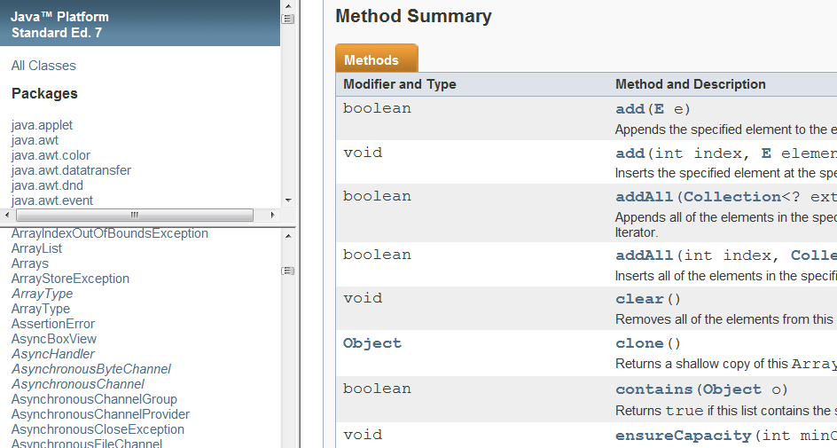
API documentation (1/3)
2. ArrayList
[CS1020 Lecture 6: Vector and ArrayList]

Slide 17
API documentation (2/3)
PACKAGE
import java.util.ArrayList;
2. ArrayList
SYNTAX
//Declaration of a ArrayList reference
ArrayList<E> myArrayList;
//Initialize a empty ArrayList object
myArrayList = new ArrayList<E>();
Commonly Used Method Summary
boolean | isEmpty() Returns true if this list contains no element.
int | size() Returns the number of elements in this list.
[CS1020 Lecture 6: Vector and ArrayList]

Slide 18
API documentation (3/3)
Commonly Used Method Summary (continued)
boolean | add(E e) Appends the specified element to the end of this list.
void | add(int index, E element) Inserts the specified element at the specified position in this list.
E | remove(int index) Removes the element at the specified position in this list.
boolean | remove(Object o) Removes the first occurrence of the specified element from this list, if it is present.
E | get(int index) Returns the element at the specified position in this list.
int | indexOf(Object o) Returns the index of the first occurrence of the specified element in this list, or -1 if this list does not contain the element.
boolean | contains(Object elem) Returns true if this list contains the specified element.
2. ArrayList
[CS1020 Lecture 6: Vector and ArrayList]

Slide 19
Example
TestArrayList.java
import java.util.ArrayList;
import java.util.Scanner;
public class TestArrayList {
public static void main(String[] args) {
Scanner sc = new Scanner(System.in);
ArrayList<Integer> list = new ArrayList<Integer>();
System.out.println("Enter a list of integers, press ctrl-d to end.");
while (sc.hasNext()) {
list.add(sc.nextInt());
}
System.out.println(list); // using ArrayList's toString()
// Move first value to last
list.add(list.remove(0));
System.out.println(list);
}
}
2. ArrayList
Output:
Enter a list ... to end.
31
17
-5
26
50
(user pressed ctrl-d here)
[31, 17, -5, 26, 50]
[17, -5, 26, 50, 31]
[CS1020 Lecture 6: Vector and ArrayList]

Slide 20
Practice Exercises
A bumper crop of practice exercises (exercises 15 – 21) are mounted on CodeCrunch this week
The files are also available on the CS1020 website: http://www.comp.nus.edu.sg/~cs1020/4_misc/practice.html
You are urged to work on these exercise as they are important for you to cement your basic understanding of the topics that are covered so far (OOP and arrays)
[CS1020 Lecture 6: Vector and ArrayList]

Slide 21
Practice Exercises
Vector and ArrayList
#15: Missing Digits version 2
Using Vector
#16: Set Containment
Using ArrayList and writing your own class
#17: Nearest Points
Using ArrayList and Point
OOP
#18: Overlapping Rectangles Version 2
#19: Overlapping Rectangles Version 3
#20: Redeem Coupon
OOP and ArrayList
#21: Turning Knobs
[CS1020 Lecture 6: Vector and ArrayList]

Slide 22
Detecting Duplicates (1/4)
Using ArrayList class and random number generation.
You may use the Math random() method or the Random class
Write a program DetectDuplicates.java to read the following values:
The number of unique random integers to generate; and
Limit of the values: each random number generated should be in the range from 0 (inclusive) to limit (exclusive), or [0, limit – 1].
(Certainly, the second input value must not be smaller than the first)
Each time a random integer is generated, you must check if it is a duplicate of an earlier generated value. If it is, it must be discarded. The program goes on to generate the required number of unique random integers.
You are to count how many duplicates were detected.
Additional Exercise
[CS1020 Lecture 6: Vector and ArrayList]

Slide 23
Detecting Duplicates (2/4)
Sample run
(In testing your code, each time a random number is generated, you may want to print it to check that the computation is correct)
Additional Exercise
Enter number of unique integers to generate: 10
Enter limit: 20
List: [16, 3, 15, 17, 2, 10, 18, 5, 12, 14]
Duplicates detected: 8
[CS1020 Lecture 6: Vector and ArrayList]

Slide 24
Detecting Duplicates (3/4)
DetectDuplicates.java
import java.util.*;
public class DetectDuplicates {
public static void main(String[] args) {
Scanner sc = new Scanner(System.in);
ArrayList<Integer> list = new ArrayList<Integer>();
System.out.print("Enter number of unique ...: ");
int numUnique = sc.nextInt();
System.out.print("Enter limit: ");
int limit = sc.nextInt();
Random rnd = new Random();
int countUnique = 0;
int countDuplicates = 0;
int num; // the random number
Additional Exercise
[CS1020 Lecture 6: Vector and ArrayList]

Slide 25
Detecting Duplicates (4/4)
DetectDuplicates.java
System.out.println("List: " + list);
System.out.println("Duplicates detected: "
+ countDuplicates);
}
}
while (countUnique < numUnique) {
num = rnd.nextInt(limit);
if (list.contains(num)) {
countDuplicates++;
}
else {
list.add(num);
countUnique++;
}
}
Additional Exercise

[CS1020 Lecture 6: Vector and ArrayList]

Slide 26
End of file

